Slide 1

Predictive Analysis of Credit Card Default Using Machine Learning Techniques
AIT 582-DL1: Applications of Metadata in Complex Big Data Problems
Instructor: Can Nguyen, Ph.D.
Team –9
Shivani Gangarapollu - G01414041
Shashank Yelagandula - G01395790
Akhil Reddy Chimmula - G01407879
Bhavesh Kurella - G01410826

Slide 2

WHAT’S IN:
Introductions
Significance of Research
Challenges
Analytical / Methodology Approaches
Results / Findings from the research
Future Work

Slide 3
Introduction:
Investigate the impact of successful banking procedures in promoting industrial growth, economic expansion, and financial stability.
Recognize the assistance that banks offer to individuals through credit facilities, which is critical in modern economies.
OBJECTIVE: Addressing the Challenge of Credit Card Default Prediction.
In the backdrop of expanding worldwide credit card usage, address the growing issue of credit card defaults.
Consider how important it is for financial institutions to accurately detect possible defaulters.

Slide 4
SIGNFICANCE OF RESEARCH:
1. Optimizing Financial Stability:
Predicting credit card failures more precisely assists banks in controlling credit risks, helping to the financial sector's overall stability.
2. Helping to Promote Responsible Lending Practices:
enhances lending practices, enabling banks to give loans responsibly and shield customers from financial distress.
3. Financial Analytics Advancement:
Our work enhances credit risk assessment by utilizing machine learning, which is a major breakthrough in financial analytics.
4. Customer Debt Management:
encourages customers to adopt better financial habits by setting credit limits and repayment plans that are more reasonable.

Slide 5

Recognizing the Issue with Credit Card Default:
1.Types of Credit Card Failures:
Defaults result in charge-offs, which have a significant negative financial impact on banks' balance sheets by forcing them to write off loans they are unable to collect or sell.
2. Repercussions for Customers:
A consumer's credit score is severely harmed by a default, which makes it more difficult for them to get future loans and erodes public confidence in the financial system.
3. Financial Institutions' Effect:
Banks suffer significant financial losses as a result of defaults, which impairs both their ability to lend money and their general financial stability.
4. The Project's Goal in Solving the Issue:
reduce this problem by using predictive analytics to spot possible default hazards in relation to payment trends and client information.

Slide 6

MODEL APPROACH:
1. Model Selection for Machine Learning:
Random Forest classifiers were chosen for their capacity to handle complicated, multidimensional data while producing interpretable results.
2. Addressing Class Imbalance:
To balance the dataset, we used the Synthetic Minority Over-sampling Technique (SMOTE), which ensures that our models appropriately reflect both defaulters and non-defaulters.
3. Model Evaluation Metrics:
Focused on accuracy, precision, recall, and F1-score to holistically measure model performance, which is especially important given the dataset's class imbalance.
4. Analysis of the Importance of Features:
Feature relevance ratings were used to uncover critical characteristics driving credit card default forecasts, notably in the Random Forest model.

Slide 7

DATASET DESCRIPTION:
1. UCI Machine Learning Repository Comprehensive Dataset:
Specifically curated for default prediction research, including specific credit card user habits and attributes.
2. Dimensions, Scope, and Timeline:
Covers 30,000 credit card users over a six-month period (April to September 2005), ensuring a robust and relevant sample for analysis.
3. Attributes That Are Diverse and Rich:
Includes 24 different factors such as demographics, credit limit, repayment status, and bill amounts, offering a holistic perspective of consumer credit activity.
4. Ethical Applications and Research:a
Anonymized data that adheres to ethical norms, which is widely acknowledged and used in credit risk analysis and machine learning research.

Slide 8
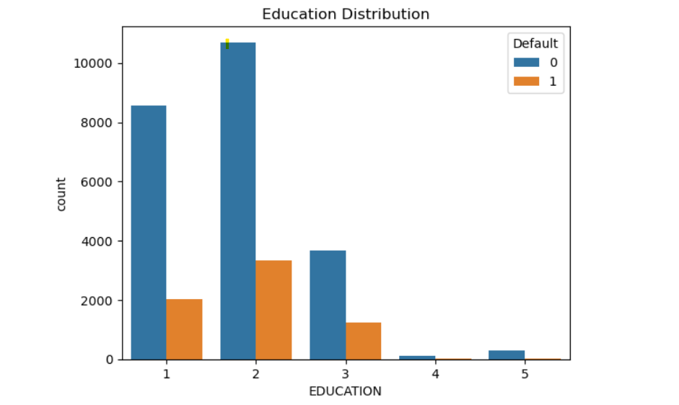
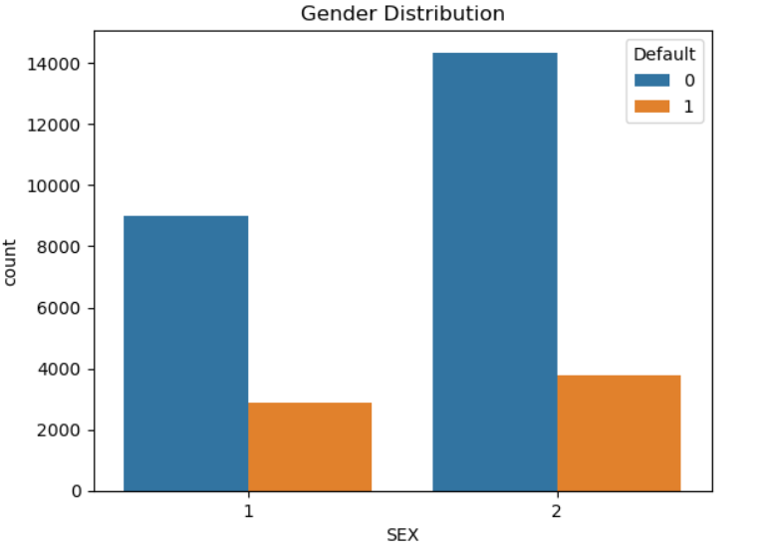
VISUALIZATIONS:
Default Rates by Education Level Analysis: This graph compares the number of credit card defaults to non-defaults across various education levels."
Gender-Specific Default Frequency: This graph analyzes the frequency of credit card defaults by gender, showing possible differences.

Slide 9
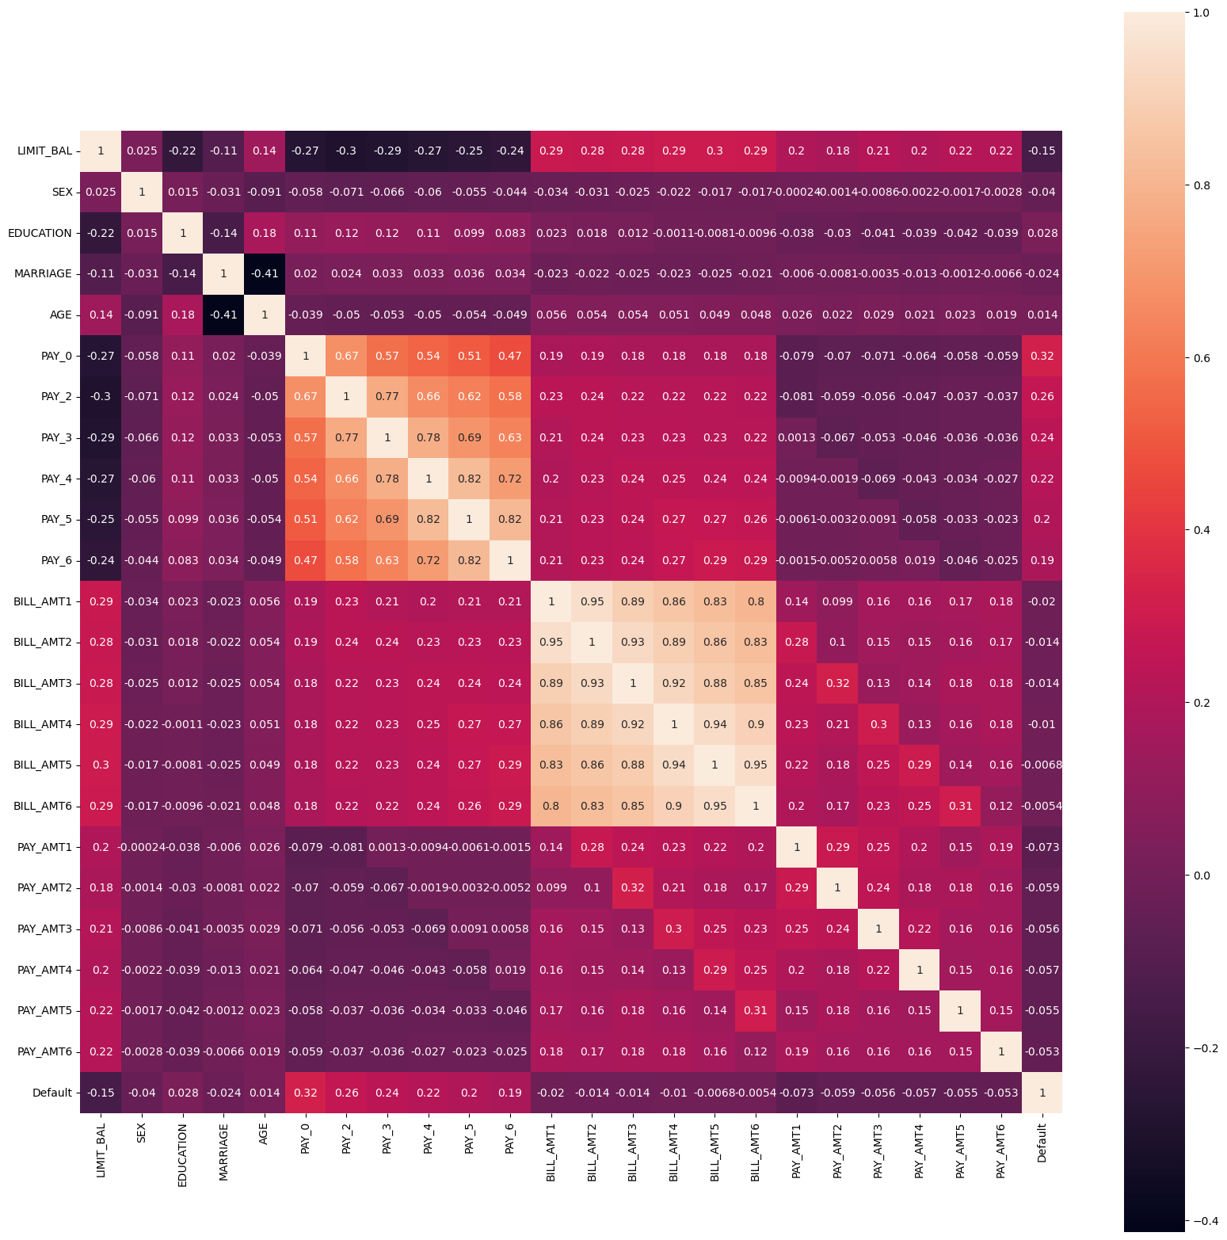
Credit Data Attribute Correlation Heatmap:
This heatmap depicts the correlation coefficients between several credit data variables, emphasizing the links that are important for predictive analysis.

Slide 10
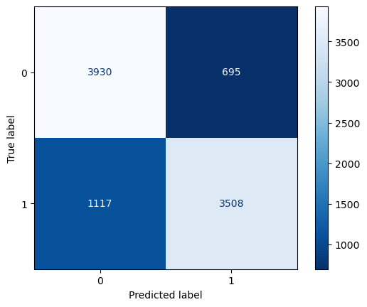
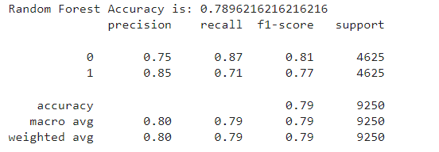
Confusion Matrix for Credit Default Prediction using Random Forest :
Random forest is a commonly-used machine learning which combines the output of multiple decision trees to reach a single result. Its ease of use and flexibility have fueled its adoption, as it handles both classification and regression problems.
The classifier matrix visualizes the model's predictive performance, with a significant number of true positives (3508) and true negatives (3930), showing a good capacity to properly identify both defaulters and non-defaulters.
The accuracy of model is about 79% . And decent Precision and Recall scores of 0.85-0.87.

Slide 11
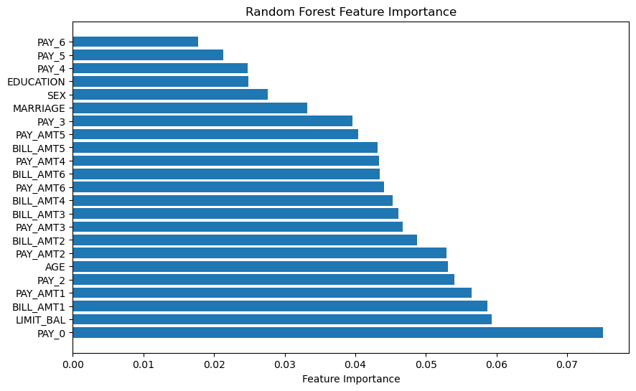
Key Drivers of Credit Card Default Prediction
This graph highlights the most relevant elements in forecasting credit card defaults by displaying the sorted relevance of characteristics employed in the Random Forest model, with repayment status appearing as the top predictor.

Slide 12
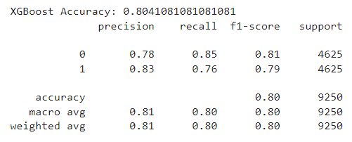
XGBoost Classifier Performance Metrics:
XGBoost (extreme Gradient Boosting) is an advanced implementation of the gradient boosting algorithm. It is fast and helps to reduce overfitting.
The model can enable proactive efforts to limit losses by accurately forecasting possible defaults, such as giving restructuring solutions to high-risk consumers before a default occurs.
XGBoost Model Evaluation: With an overall F1-score of 0.80 and a robust accuracy of 80.41%, the XGBoost classifier achieves a precision of 0.78 for non-defaulters and 0.83 for defaulters, showing a great balance between precision and recall in default prediction.

Slide 13
CHALLENGES:
1. Managing Complicated Data Sets:
Navigating the complexity of a sizable dataset with a wide range of characteristics, necessitating careful preparation to guarantee relevance and accuracy.
2. Taking Class Imbalance Aside:
Managing data that is unbalanced, such that there are comparatively fewer defaults than non-defaults, thereby distorting model predictions.
3. Keeping the Model Dependable and Accurate:
maintaining the models' dependability and generalizability by striking a balance between the requirement for high accuracy and avoiding overfitting.
4. Interpreting the Results of Machine Learning:
Converting complicated machine learning model outputs into useful insights is a crucial step in putting them to use in real-world financial decision-making.

Slide 14
FUTURE WORK:
Advanced Methods for Machine Learning:
Investigating deep learning and ensemble approaches, two more advanced machine learning techniques, to increase prediction accuracy.
Growth in Data Sources:
Enhancing the prediction model by adding data from other sources, such as social media activity or market trends.
Data Analysis in Real Time:
Creating real-time data analysis technologies that allow for dynamic and up-to-date credit risk assessment.

Slide 15
CONCLUSION:
1. Machine Learning Application Achievements:
Machine learning algorithms were successfully used to anticipate credit card defaults, improving financial risk assessment.
2. Model Effectiveness and Insights:
Gained important insights on default affecting elements; proved the efficacy of Logistic Regression, Nave Bayes, and Random Forest models.
3. Contribution and Influence:
The project benefits the academic and banking sectors by demonstrating the revolutionary power of machine learning in financial decision-making.
4. Evidence of Model Effectiveness:
Preliminary results show that our algorithms are capable of reliably predicting probable defaulters, which is an important asset for successful risk management methods in the financial industry.

Slide 16

QUESTION???

Slide 17

THANK YOU!

